Slide 1


CAR INSURANCE
IN ACTION
Showcasing different scenarios that
would trigger car insurance events!
Name : Abdallah Reda Elsayed
Instructor : Ahmed Ayman

Slide 2

DATASET
The company has shared its annual car insurance data. Your task is to uncover real customer behaviors from this dataset.
The columns represent practical, real-world features.
Outcome column:
- 1 → Customer has claimed their insurance
- 0 → Customer has not claimed their insurance

Slide 3
AGE : Age group of the driver (e.g., 16–25, 26–39, etc.)
GENDER : Gender of the driver (male or female)
RACE : Ethnic background of the driver
DRIVING_EXPERIENCE: Driver’s experience in years (in ranges like 0-9y, 10-19y, etc.)
EDUCATION: Driver’s highest education level (none, highschool, university, etc.)
INCOME: Income group (poverty, working class, middle class, upper class)
VEHICLE_OWNERSHIP: Whether the driver owns a vehicle (1 = yes, 0 =no)
VEHICLE_YEAR: Whether the vehicle is newer (after 2015) or older (before 2015)
MARRIED: Marital status (1 = married, 0 = not married)
CHILDREN: Number of children the driver has

Slide 4
ANNUAL_MILEAGE : Estimated miles driven per year
SPEEDING_VIOLATIONS : Number of speeding tickets
PAST_ACCIDENTS : Number of past accidents
DUIS : Number of DUI (Driving Under Influence) offenses
CREDIT_SCORE : Credit score of the driver (continuous numerical feature)
🎯 Target Variable : OUTCOME
Whether the driver filed an insurance claim (1 = yes, 0 = no)

Slide 5

STEPS OF PROJECT :
1
UDERSTANDING
4
MODELING
2
EXTRACT FEATURE
EDA
5
CHOSSE THE BEST
3
PRE-PROCESSING
6
DEPLOYMENT

Slide 6
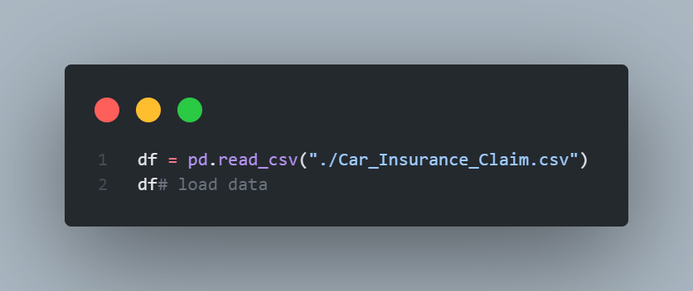
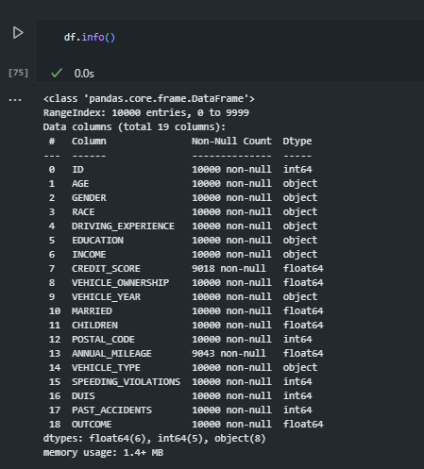
1 ) UNDERSTANDINGDATA

Slide 7
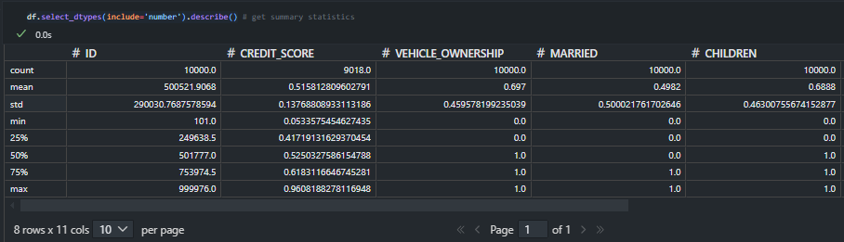
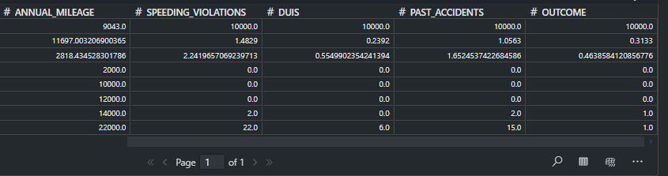
1 ) UNDERSTANDINGDATA

Slide 8
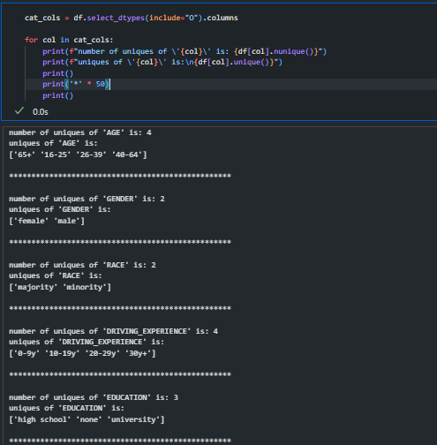
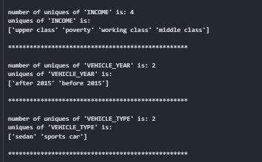
1 ) UNDERSTANDINGDATA

Slide 9
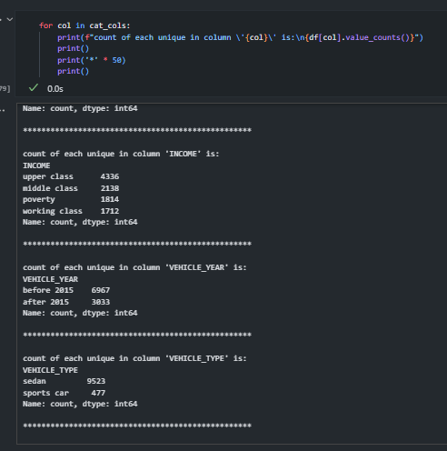
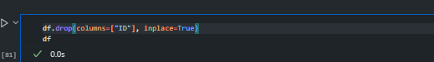
1 ) UNDERSTANDINGDATA

Slide 10

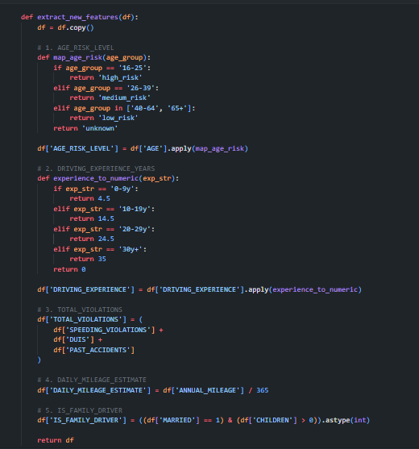
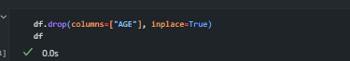
EXTRACT FEATURE
EDA

Slide 11
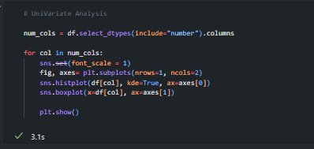
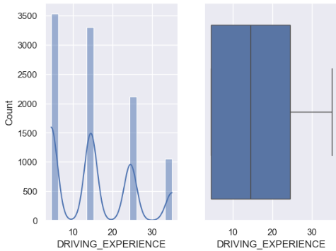
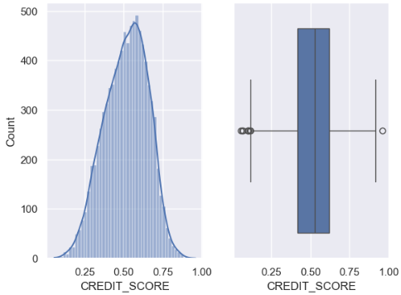
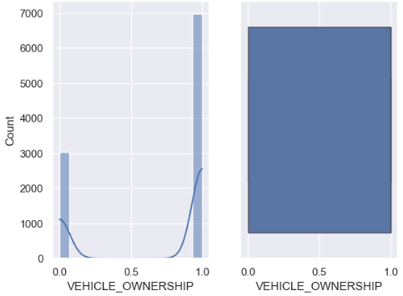
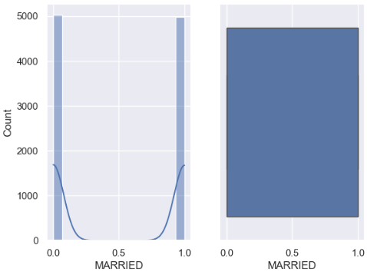
EXTRACT FEATURE
EDA

Slide 12
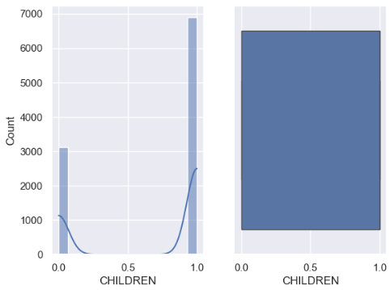
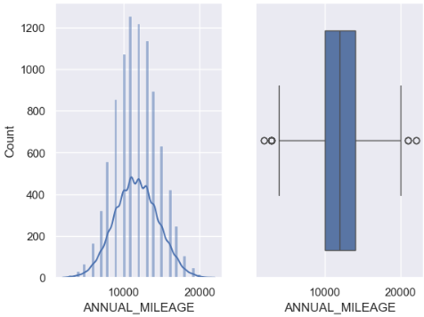
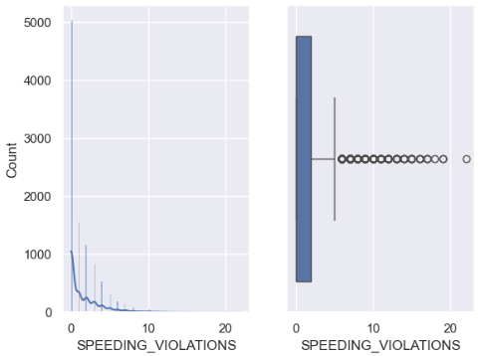
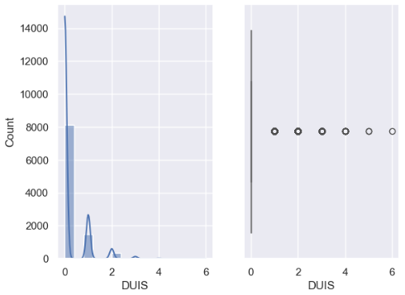
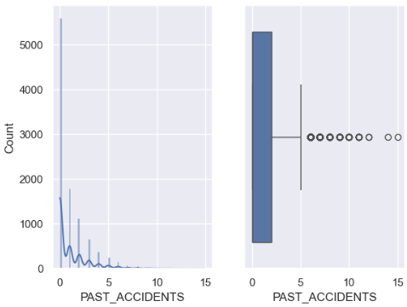
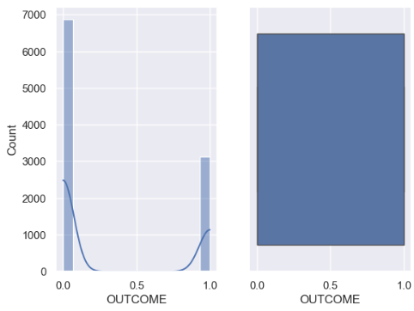
EXTRACT FEATURE
EDA

Slide 13
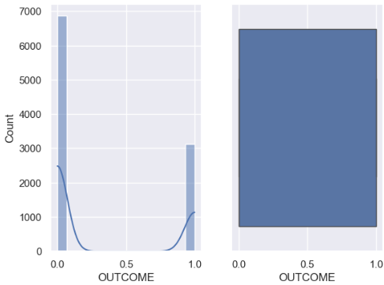
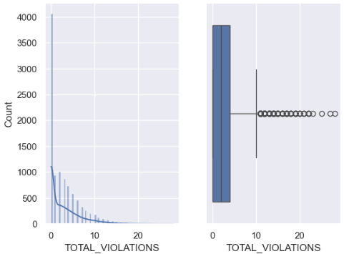
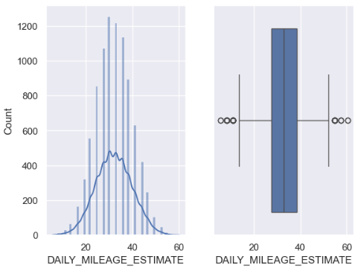
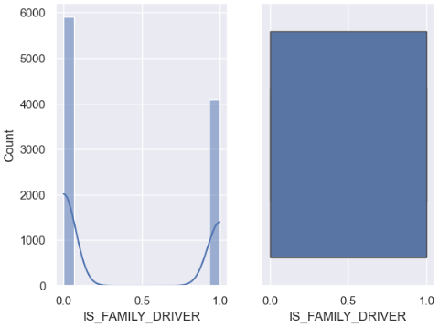
EXTRACT FEATURE
EDA

Slide 14
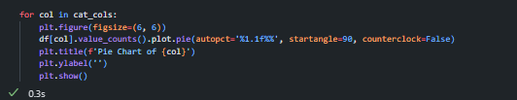
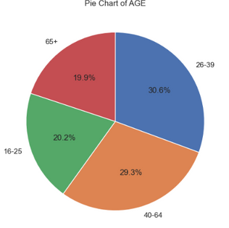
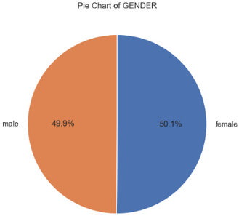
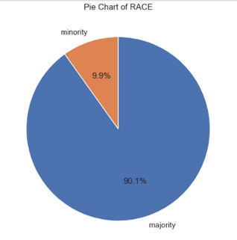
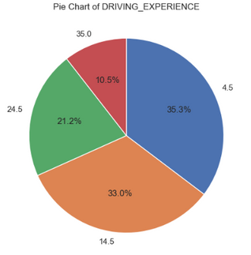
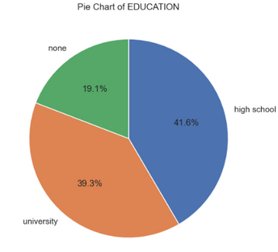
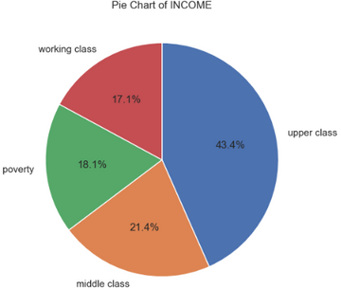
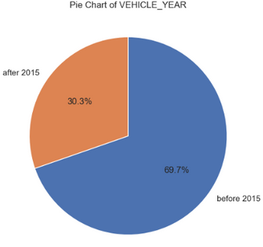
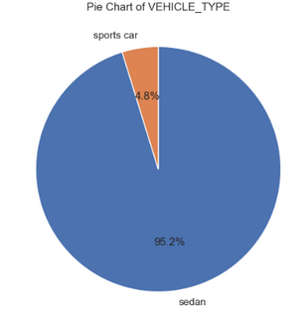
EXTRACT FEATURE
EDA

Slide 15
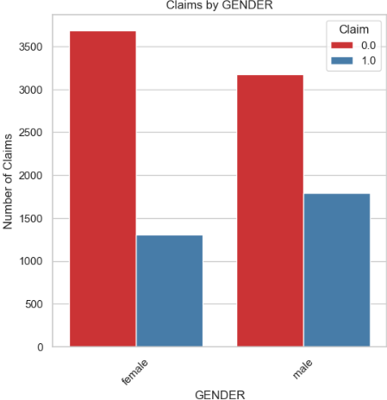
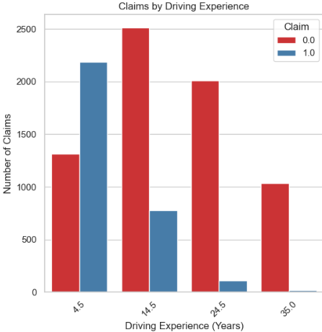
EXTRACT FEATURE
EDA
What demographic groups are most likely to file an insurance claim?
Does driving experience significantly reduce the likelihood of an accident claim?

Slide 16
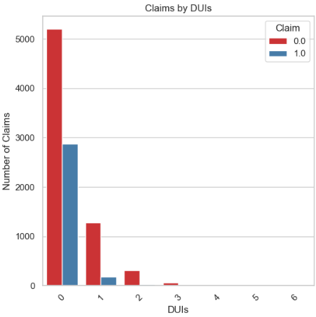
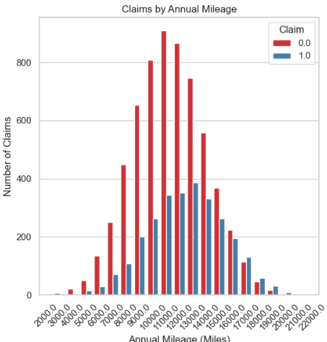
EXTRACT FEATURE
EDA
How does annual mileage impact the probability of filing a claim?
Do drivers with DUIs or past violations file more claims?

Slide 17
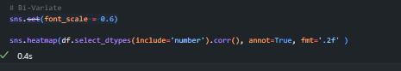
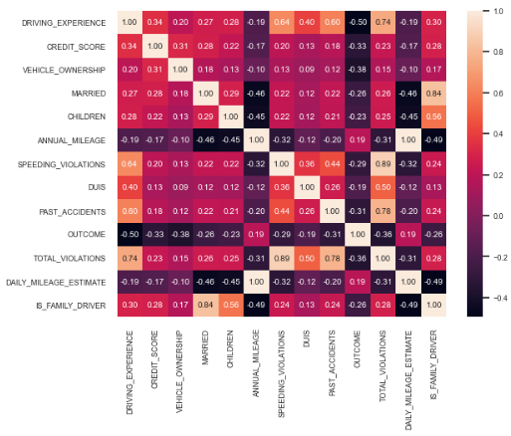
EXTRACT FEATURE
EDA

Slide 18
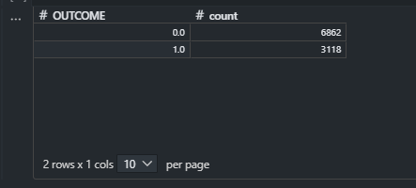
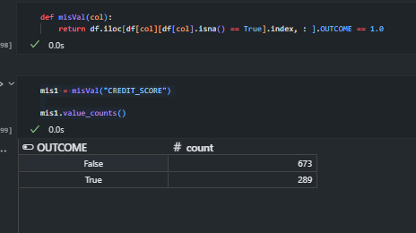

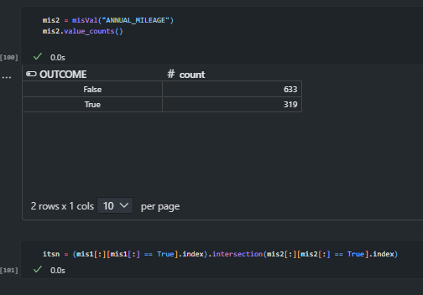
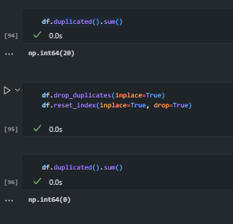
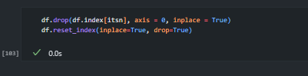
PRE-PROCESSING

Slide 19
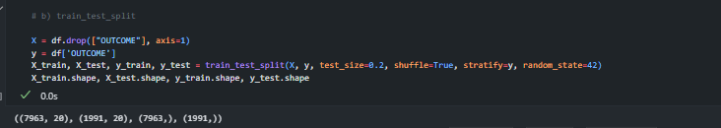
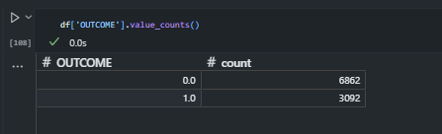
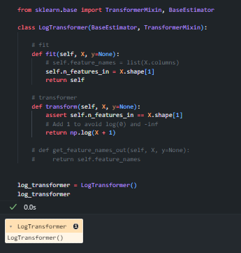
PRE-PROCESSING

Slide 20
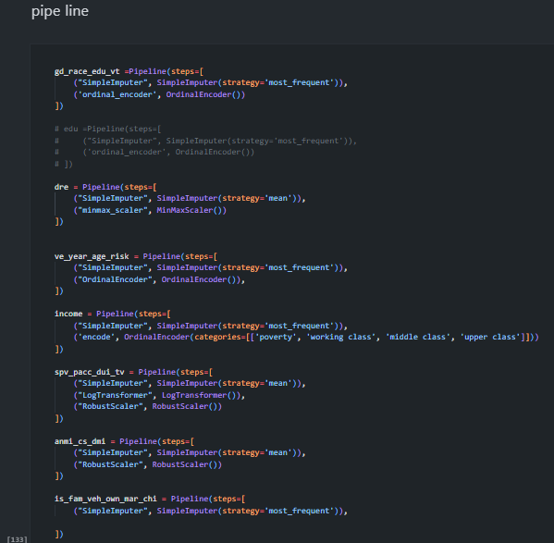
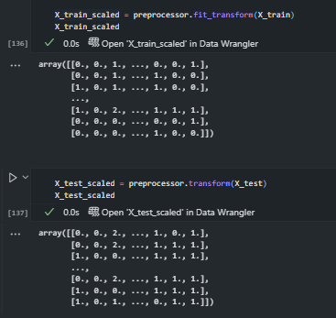

PRE-PROCESSING

Slide 21



MODELING

Slide 22
MODELING

Slide 23


MODELING

Slide 24



MODELING

Slide 25


MODELING

Slide 26


MODELING

Slide 27


MODELING

Slide 28



MODELING

Slide 29


MODELING

Slide 30


MODELING

Slide 31


MODELING

Slide 32




MODELING

Slide 33


MODELING

Slide 34


MODELING

Slide 35


MODELING

Slide 36



MODELING

Slide 37


MODELING

Slide 38


MODELING

Slide 39


MODELING

Slide 40

MODELING

Slide 41

MODELING

Slide 42

MODELING

Slide 43


MODELING

Slide 44




MODELING

Slide 45



MODELING

Slide 46


MODELING

Slide 47


MODELING

Slide 48

MODELING

Slide 49


MODELING

Slide 50


MODELING
CHOOSEING THE BEST MODE

Slide 51


MODELING

Slide 52


MODELING

Slide 53


MODELING

Slide 54


MODELING

Slide 55


MODELING

Slide 56


MODELING

Slide 57

SAVE MODLE

Slide 58

DEPLOYMENT
USING FLASK

